Slide 1
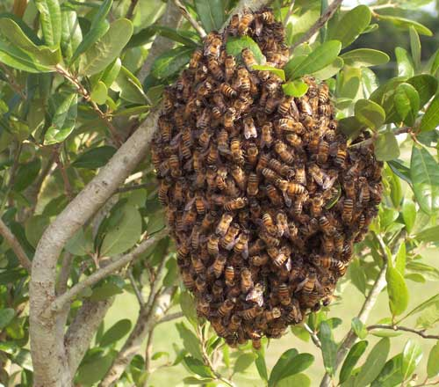
Swarm Recognition, Management (Splits), and Capture
Bob Livingston, Master Beekeeper
Apalachee Beekeeper’s Assn., Inc.
February 13, 2024

Slide 2
What is a honey bee swarm?
A natural division of the hive’s population
Done to propagate the species
The mechanism for the colony to reproduce itself.
The normal response of a hive to success

Slide 3
Mechanics of swarming
The old queen and around 60% of worker bees leave the hive to start a new colony
Queen flys to a nearby bush or tree limb and worker bees join her and form into a cluster surrounding the queen
Scout bees locate a new home and return to the swarm and lead it to the new home.

Slide 4
Types of honeybee swarms.
Overcrowding Swarms
  No place for bees to put nectar so they backfill the brood nest
    Prevent by adding supers
  Honey/pollen clogging the brood nest so that queen has nowhere to lay.
    Remove honey and add empty comb
  No place to cluster near the brood nest and queen
    Add slatted racks to bottom and/or follower boards to insides
  Too much traffic congestion in the brood nest
    Provide a top entrance

Slide 5
Types of honeybee swarms.
Reproductive Swarm
  Bees build up until they have enough bees and then start backfilling brood nest with honey
    Stops queen from laying
    Makes nurse bees unemployed
  Bees start swarm cells at bottom of frames
  Swarm start about the time swarm cells are capped

Slide 6
How to prevent an immanent swarm?
Destroy queen cells before they are capped
  Will delay swarming until they replace cut out queen cells.
    Must make sure you get them all.
Do a cut down split
  Move old queen and all but one frame of open brood to a new location
    Old hive won’t split because no queen and open brood
    New hive won’t swarm because of few foragers.
If queen cells are already capped leave alone
    Hive has already swarmed
    Can make splits using extra queen cells but leave one or two in swarmed hive to provide a replacement queen.

Slide 7
Managing to prevent swarming
Open up the brood nest
  Put empty frames (no foundation) in the brood nest between two frames of brood.
    Forces nurse bees to build more comb
  Add another brood box
  Nectar management (Walt Wright)
    Intersperse drawn comb and capped honey over the brood nest.
      Fools bees into thinking they don’t have enough stores to swarm
  Split and re-queen with a new young queen.
    Young queens less likely to swarm

Slide 8
Signs of swarming?
Excessive number of bees on outside of hive
  Hanging from bottom is a conical fashion
  Covering the front of the box in a scattered fashion
  Facing downward and appearing overactive and jittery
    Don’t confuse with bearding where bees are on outside of hive and fanning to cool off and vent the hive

Slide 9
What is a “split”?
Dividing a single hive of honeybees into two or more smaller hives.

Slide 10
Why should I make “splits”
Most cost effective way to add additional hives each year.
  No need to buy packages/nucs
  Only cost is time, feed and maybe a new queen if you don’t raise your own
Prevent swarming
To produce nucs for sale to other beekeepers
  Good way to generate additional income
Increase production

Slide 11
Why should I make splits 2
Raise Queens
  Establish mating nucs
    Introduce mature queen cells or virgin queens
    Virgin queens mate and start laying
    Remove mated queens to re-queen your own hives or sell mated queens to others
    Repeat the process

Slide 12
When to do a “split”
As soon as new commercial mated queens are available
Or as soon as drones are flying if you want to raise your own queens
  With few colonies of your own or nearby you run the risk of not having an adequate numbers of drones available to mate with a virgin queen

Slide 13
Concepts of making splits
Make sure both of the resulting colonies have:
  a queen or the resources to make one
  eggs or very young larvae just hatched from eggs
  drones flying to mate with virgin queen
  pollen and honey to feed both colonies
  plenty of nurse bees in each hive to adequately care for the brood
  respect the natural structure of the brood nest
    Brood combs belong together

Slide 14
How to do a “split”
There are an infinite variety of ways to do a split depending on what you want for an outcome.

Slide 15
Types of splits
Even split
  Divide everything equally
Cut down Split
  Increase honey production
Swarm control split

Slide 16
Even Split
Take half of everything and divide it up between the parent hive and new hive

Slide 17
Walk away split
Take
  The old queen
  One frame of eggs
  Two frames of emerging brood
  Two frames of pollen and honey
  Put in a 5 frame nuc box
  Shake in extra nurse bees
  Put the covers back on and walk away
  Come back in 4 weeks to see if the new queen is laying or
  Introduce a mated queen
    Introducing a mated queen will put the hive three weeks ahead of a hive raising their own queen

Slide 18
Cut down split
Free up bees to forage by minimizing amount of brood and free up nurse bees to become foragers
  Move old queen and almost all open brood honey and pollen into a new hive (leave one frame containing eggs in parent hive)
    It will take parent hive 16 days to make a new queen from frame of eggs left in parent hive
    Parent hive won’t swarm because they are queenless and have minimal brood
    Split won’t swarm because they have no foragers.
      Foragers returned to parent hive
  Timing is critical
    Should be done shortly before the main nectar flow
    Especially good for production of comb or section honey (Ross Rounds)

Slide 19
Swarm Control Split
Take
  old queen
  One frame of open brood
  one frame of capped brood
  one frame of honey & pollen
  Two frames of drawn or new foundation
    Can do old queen & one frame of brood, one frame of pollen & honey and 3 frames of drawn comb/new foundation but will take longer to build out the nuc
  Put into a 5 frame nuc box
  Move nuc box to a new location
  Introduce a mated queen into parent hive or make sure you leave at least one frame of eggs & young brood in parent hive so they can produce a new queen
    Introducing a mated queen will put the hive three weeks ahead of a hive raising their own queen
  Come back in 4 weeks to see if the new queen is laying
  Remove old queen and re-queen nuc if planning to sell the nuc

Slide 20
Swarm Control Split continued
Parent hive is queenless and bees and some stores gone so parent hive thinks it has swarmed.
Nuc has queen but minimal amounts of bees, brood and stores so they’re not strong enough to swarm

Slide 21
Frequently Asked Questions
How early should I split
  Really depends on when commercial mated queens are available or adequate drones are flying to mate with virgin queens
How many times can I split
  Very strong hives can be split 4 or 5 times per year but probably won’t make a honey crop
  Weak hives may stay too weak to split all year
Should I move the splits or parent hives to another location
  Not entirely necessary but should consider moving the split(s) to a new location two or more miles away to prevent drifting and robbing.

Slide 22
Doolittle Method
Need a conversion board or a queen excluder and boards to cover the “wings”
Open the parent hive and pull one frame of sealed and emerging brood, one frame of honey and one frame of pollen.
Switch out emerging brood with a frame of eggs and young larvae if planning to let the nuc raise their own queen.

Slide 23
Doolittle 2
Replace frames taken from parent colony with frames of drawn comb or new foundation
Place the queen excluder/conversion board on top of hive.
Center a 5 frame nuc box on top of the queen excluder/conversion board.
Put the wing covers in place if not using a conversion board.

Slide 24
Doolittle 3
Gently shake or brush all the bee on the 3 pulled frames right at entrance to hive.
Put the 3 shaken frames in the nuc box along with two empty frames of drawn comb or new foundation.
Nurse bees will be attracted up through the queen excluder to the emerging brood.
House bees will be attracted to the pollen & honey frames.

Slide 25
Doolittle 4
The next day, remove the nuc box and install a new mated queen or queen cell.
Advantages
  Make a split without having to find the old queen
  You get the right age of bees to make the nuc work
Disadvantages
  Old queen is still in the parent hive and could swarm later.

Slide 26
Fla. Best Management Practices for Maintaining European Honey Bee Colonies
Honey bee colony divisions or splits should be requeened with production queens or queens cells from European honey bee breeders following Florida best Management Practices.
  Beekeepers are discouraged from allowing colonies to produce their own queens
Florida beekeepers should practice good swarm management techniques to prevent an abundance of virgin queens and their ready mating with available African honey bee drones that carry the defensive trait
Recommend re-queening every 6 months unless using marked or clipped queens and having possession a bill-of-sale from an European honey bee producer
Immediately re-queen with a European queen if previously installed marked or clipped queen is found missing
Maintain one European drone source colony (250 sq.in. of drone comb) for every 10 colonies in order to reduce supercedure queens mating with African honey bee drones.

Slide 27
Splitting a Honey Bee Hive
Elmore Herman, Millie Bee
http://www.youtube.com/watch?v=6FmnHHCftfU

Slide 28
Capturing Swarms
Swarms are usually docile
  No nest to protect and workers gorged with honey
Wear your protective gear.
Inspect the swarm for visible signs of mites or disease
Clear the area below swarm
Put cardboard box, hive body, bucket, etc. below the swarm
Sharply shake the limb downward to make bees fall into capture device.
Shake bees from capture device into hive or nuc, cover and place close to where cluster was located
Other bees will enter the hive by nightfall and you can return, close up the hive and transport to your bee yard.
May need ladder, rope or other equipment depending on how high/where the swarm is located
But, when they’re a little too high to reach……………

Slide 29
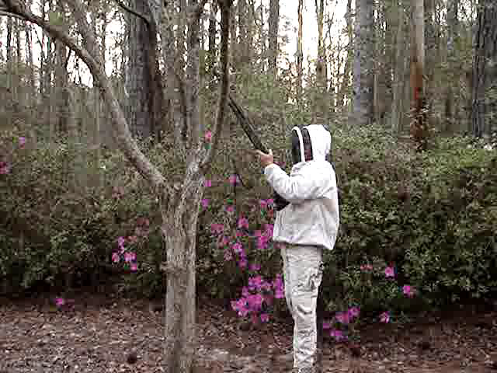
Advanced Hive Capture Methods
Do not try this at home
I am a trained professional
https://www.youtube.com/watch?v=lFymc6jbtFg

Slide 30
Steele Methods
https://www.facebook.com/lhaley44/videos/10212306378755147/

Slide 31
Credits
Michael Bush, Bush Bees
  http://www.bushfarms.com/bees.htm
  Author “The Practical Beekeeper
  Beekeeping Naturally”
David Burns, Long Lane Honey Farm
  http://www.honeybeesonline.com/blesson15.html
Elmore Herman, Millie Bee
DOACS Bureau of Plant & Apiary Inspection
  http://www.freshfromflorida.com/pi/plantinsp/apiary/apiary.html

